Slide 1
Demo Website Introduction
Author:Jimmy

Slide 2
Purpose
讓履歷加分
讓面試官有更明確的依據可以評斷我的能力
讓未來的同事了解我的Coding Style
對自己這些年的技能做個總結

Slide 3
Author Profile

Slide 4
Advantage
I am a hard-working and efficient man
I am a full-stack engineer
I have been in the IT industry for 7 years, and have a lot of practical experience in projects
I have high stability, I have done every job for at least 2 years
Have good experience with AWS Solution
Have good experience with CI/CD

Slide 5
Technology Architecture

Slide 6
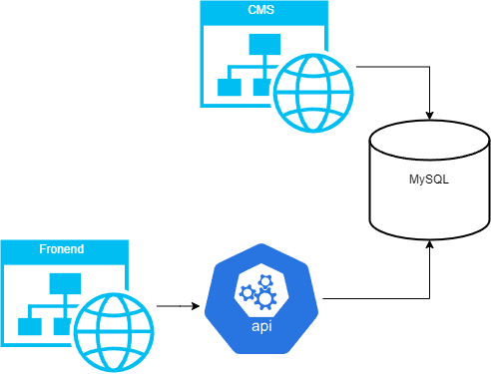
整體架構

Slide 7
Frontend

Slide 8
Architecture
使用 React + NextJs
使用 Tailwind CSS
呈現多種網站常見功能
RWD
簡易電商，提供產品搜尋、下單

Slide 9
Web API

Slide 10
Architecture
使用 .NET 7 Web API
Rest API
使用 NUnit
提供Frontend所需的資料
訂單流程
綠界金流API串接
OAuth2

Slide 11
CMS

Slide 12
Architecture
使用 .NET 7 MVC framework
使用 Bootstrap 5 + Sass
提供新增、維護產品資料
提供訂單查詢

Slide 13
Infrastructure

Slide 14
Architecture
AWS Solution
OS : Linux
Server : Nignx
Docker

